Slide 1
Surface area of cuboids
Perimeter, area and volume

Slide 2
how to use Oak lessons

Slide 3
I can appreciate the concept of surface area and find the surface area of cuboids.

Slide 4
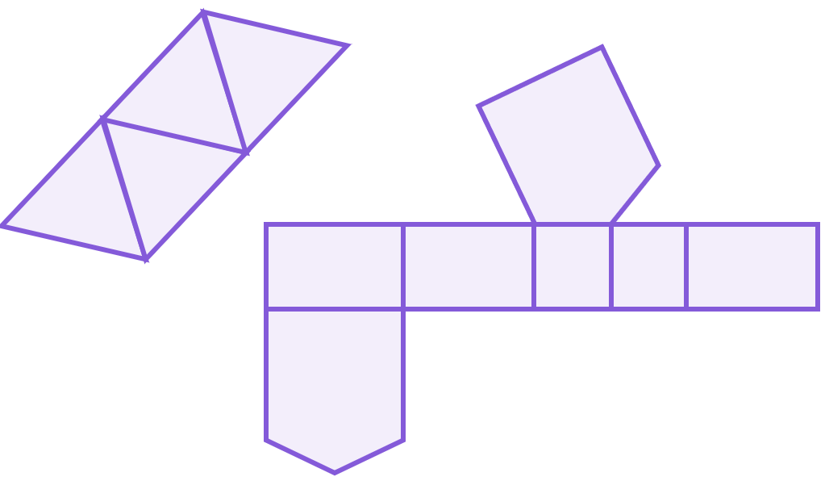
The net of a 3D object is a 2D representation of its surfaces that can be folded up into the 3D object.
The surface area is the total area of all the surfaces of a closed 3D shape. The surfaces include all faces and any curved surfaces.

Slide 5
Faces are the flat 2D surfaces of a 3D shape.
An edge is a line segment forming the boundary of the shape connecting two vertices. In 3D shapes an edge is formed where two faces meet.
A vertex is the point where two or more line segments meet. The plural is vertices.

Slide 6

Surface area of cuboids
Nets of cuboids
Surface area of cuboids from nets
Surface area of cuboids from 3D representations

Slide 7
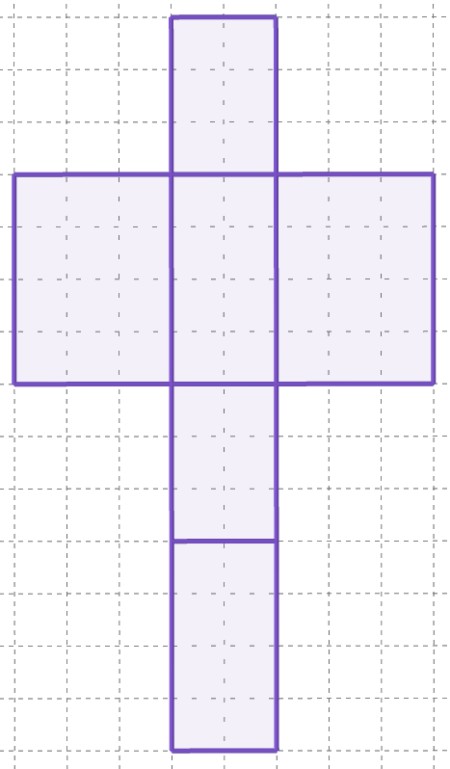
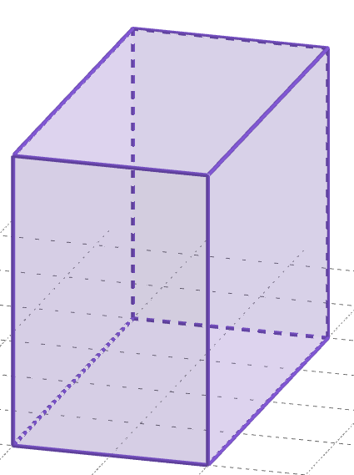
Nets of cuboids
The net of a 3D object is a 2D representation of the faces of the object.
This is a 3D object.

Slide 8

Nets of cuboids
All the faces of an object, when represented as a net, must have edges that are touching the adjacent edge of another face.
This is a 3D object.
This common edge of these two faces must be touching…
and not separated.

Slide 9
Nets of cuboids
A cuboid is a 3D shape that has 6 rectangular faces.
Each face has a matching congruent face on the opposite side of the cuboid.
front and back
left and right
top and bottom

Slide 10
Nets of cuboids
A cuboid is a 3D shape that has 6 rectangular faces.
Therefore, the net of a cuboid must have the same properties:
6 faces total
three pairs of congruent faces
right
back
bottom
front
top
left

Slide 11
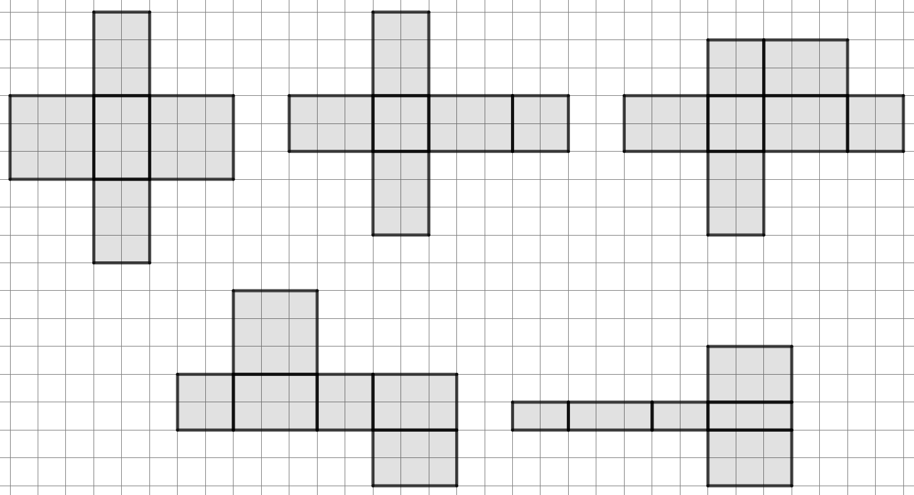


Nets of cuboids
Which of these are possible nets of a cuboid?
a
b
c
d
e

Slide 12
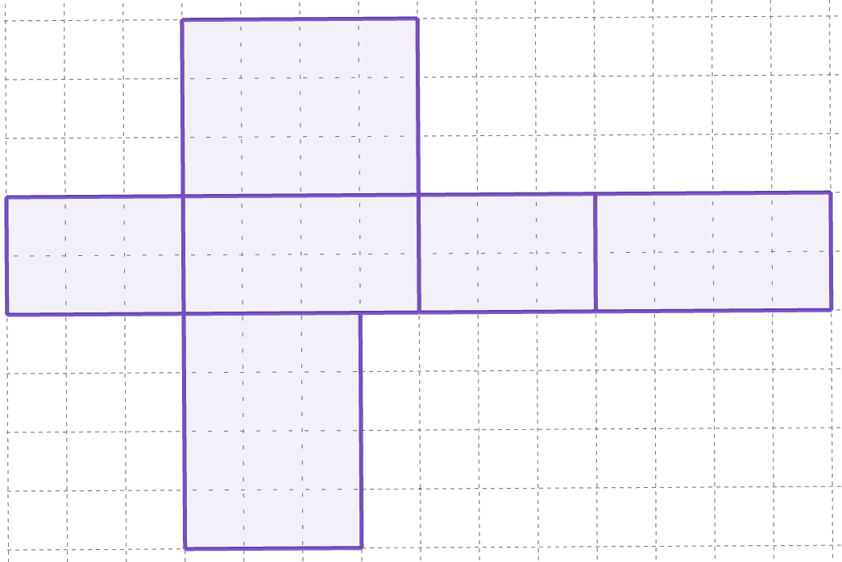
Nets of cuboids
Two edges of two rectangular faces that touch have to be the same length in order for it to fold into a cuboid.
right
back
bottom
front
top
If this edge was a different length for the bottom and right faces…
left
What would it look like when folded up?
There would be a hole or gap in the 3D shape.

Slide 13
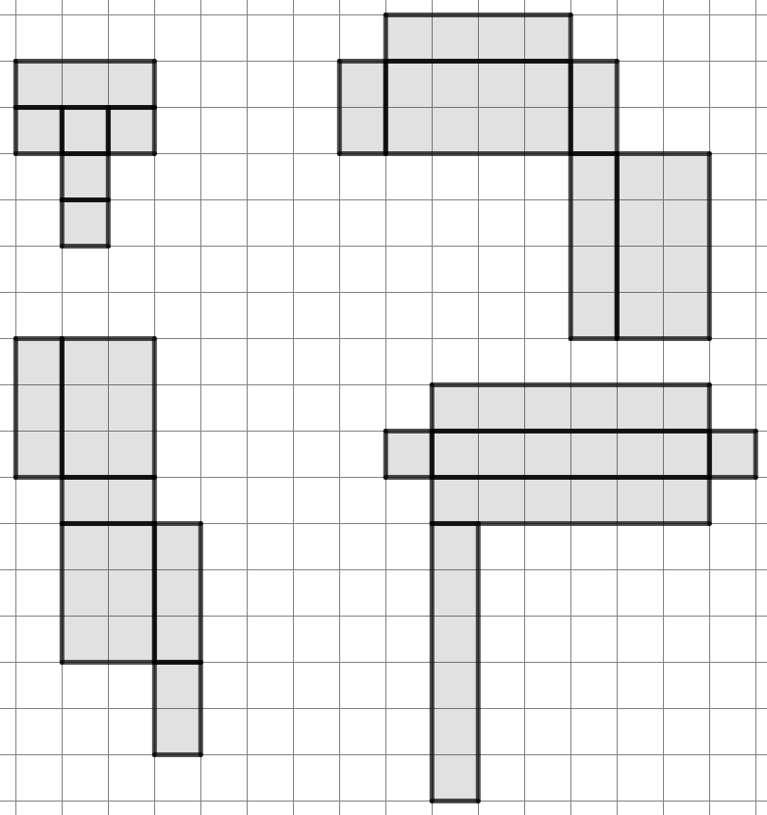
Nets of cuboids
Which of these are possible nets of a cuboid?
a
c
b
d

Slide 14
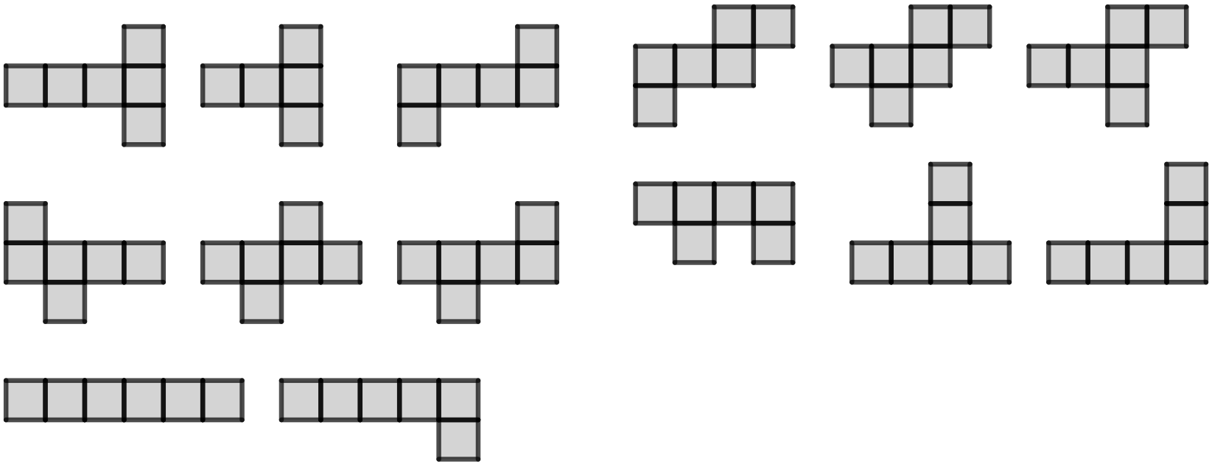
Nets of cuboids
1) Groups are either: all nets that can fold up into cubes, or all composite shapes that won’t fold up into cubes.
a) Can you spot any patterns or similarities with each of the shapes in a group?
b) Which groups can fold up into cubes, and which can’t?
c) Can you come up with any potential rules for arrangements of 6 squares that definitely are or definitely are not nets of cubes?
d) There is one unique net (not a rotation or reflection of one in a group) that isn’t given.
Can you draw this missing net and fold it up into a cube to check?
A
1
A
2
A
3
B
1
B
2
B
3
C
1
C
2
D
1
D
2
D
3
E
1
E
2
E
3

Slide 15
Nets of cuboids
1) Groups are either: all nets that can fold up into cubes, or all composite shapes that won’t fold up into cubes.
a) Can you spot any patterns or similarities with each of the shapes in a group?
A
1
A
2
A
3
B
1
B
2
B
3
There are many possible observations, for example:
C
1
C
2
All the shapes in group A have a horizontal line of four squares, with one square above and below it that move around.
Group C have 5 or 6 squares in a row, which is more than any other group.
D
1
D
2
D
3
E
1
E
2
E
3

Slide 16
Nets of cuboids
1) Groups are either: all nets that can fold up into cubes, or all composite shapes that won’t fold up into cubes.
b) Which groups can fold up into cubes, and which can’t?
A
1
A
2
A
3
B
1
B
2
B
3
Groups A, B, and D all fold into cubes.
C and E do not.
C
1
C
2
D
1
D
2
D
3
E
1
E
2
E
3

Slide 17
Nets of cuboids
1) Groups are either: all nets that can fold up into cubes, or all composite shapes that won’t fold up into cubes.
c) Can you come up with any potential rules for arrangements of 6 squares that definitely are or definitely are not nets of cubes?
A
1
A
2
A
3
B
1
B
2
B
3
C
1
C
2
No arrangement with 5 or more squares in a row or column can make a cube.
Squares distributed into only two rows or columns cannot make a cube, but it is possible for three rows.
D
1
D
2
D
3
E
1
E
2
E
3

Slide 18
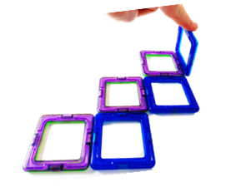
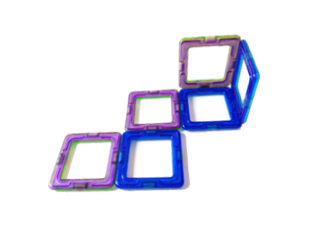
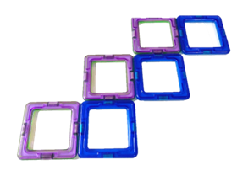
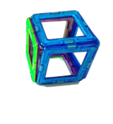
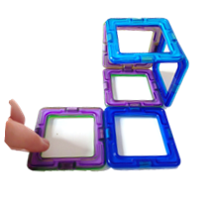
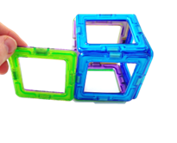
Nets of cuboids
1) Groups are either: all nets that can fold up into cubes, or all composite shapes that won’t fold up into cubes.
d) There is one unique net (not a rotation or reflection of one in a group) that isn’t given.
Can you draw this missing net and fold it up into a cube to check?
A
1
A
2
A
3
B
1
B
2
B
3
C
1
C
2
D
1
D
2
D
3
E
1
E
2
E
3

Slide 19
Surface area of cuboids
Nets of cuboids
Surface area of cuboids from nets
Surface area of cuboids from 3D representations

Slide 20
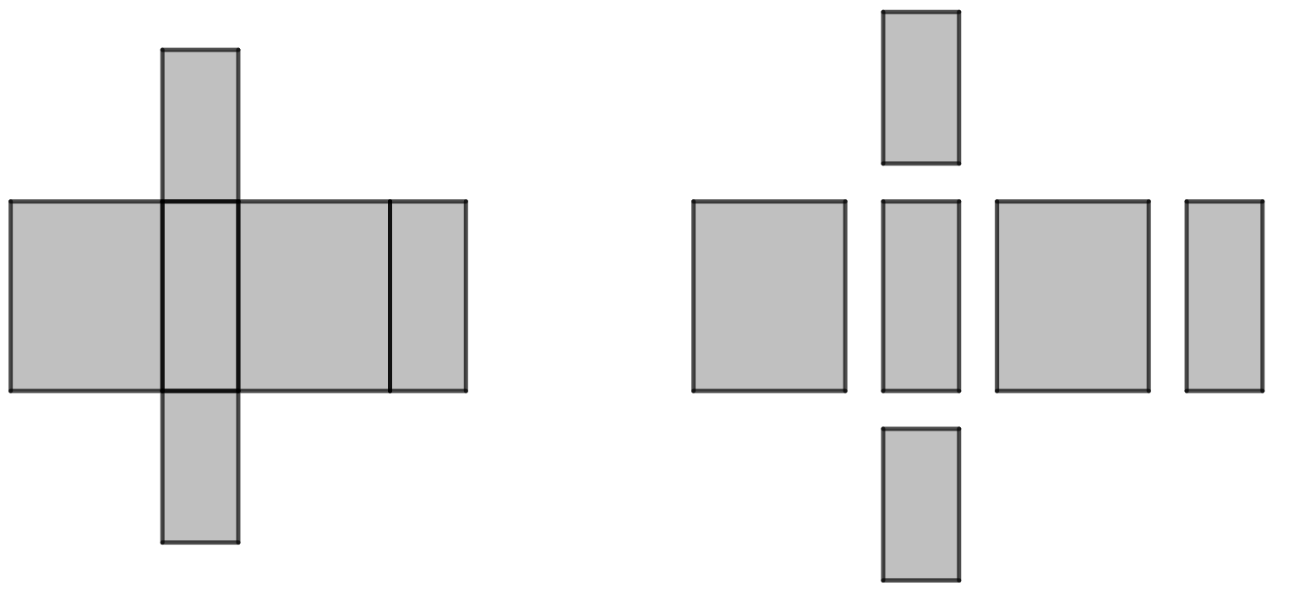
Surface area of cuboids from nets
The area of one rectangle is its length multiplied by its width.
Here we have five other rectangles.
Find the area of each one.
128 cm²
16 cm
320 cm²
160 cm²
320 cm²
160 cm²
20 cm
8 × 16 = 128 cm²
8 × 20 = 160 cm²
16 cm
16 cm
8 cm
128 cm²
16 cm
The other three rectangles are congruent to one of the first three we calculated, so their areas will be the same as the first three.
Which known area matches with which other rectangle?
the area of this rectangle is
20 × 16 = 320 cm²
8 cm

Slide 21
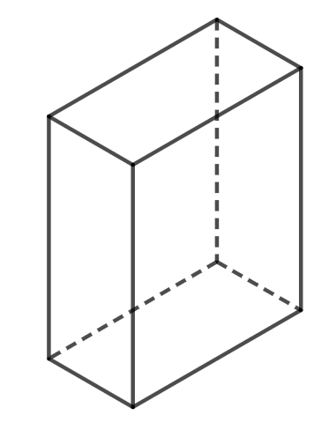
Surface area of cuboids from nets
If we connect these rectangles together, they will become a net of a cuboid!
160cm²
128 cm²
128 cm²
320 cm²
160 cm²
320 cm²
320 cm²
160 cm²
320 cm²
160 cm²
160 cm²
128 cm²
320 cm²
128 cm²
128 cm²
The surface area of this cuboid is the sum of all six faces of its net.
128 + 128 + 320 + 320 + 160 + 160 =
1216 cm²

Slide 22
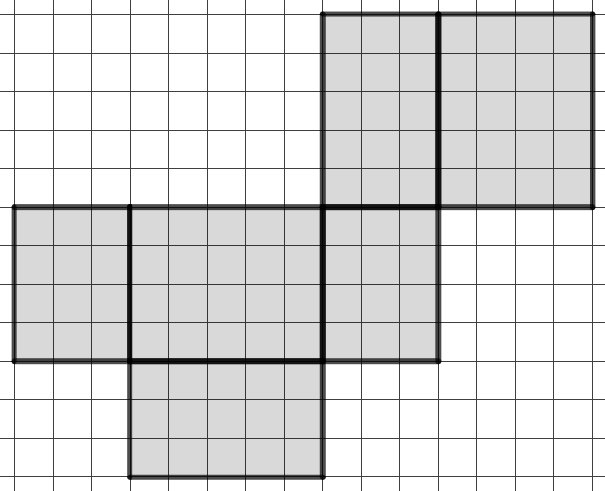
Surface area of cuboids from nets
This is a net of a cuboid.
Use the grid squares inside each rectangle to find the total surface area of the cuboid after the net is folded.
3 × 5 =
15
5 × 4 =
20
3 × 4 =
12

Slide 23
Surface area of cuboids from nets
The total surface area of the cuboid will be
12 + 12 + 20 + 20 + 15 + 15
3 × 5 =
15
5 × 4 =
20
What do you notice about these 6 numbers?
3 × 4 =
12
5 × 4 =
20
3 × 4 =
12
There are three pairs of numbers.
This is because there are three pairs of congruent rectangles!
3 × 5 =
15

Slide 24
Surface area of cuboids from nets
The total surface area of the cuboid will be
12 + 12 + 20 + 20 + 15 + 15
3 × 5 =
15
5 × 4 =
20
2(12 + 20 + 15)
= 94 units²
2 lots of 12, 20, 15
Another way of calculating the total surface area uses brackets.
3 × 4 =
12
5 × 4 =
20
3 × 4 =
12
Either method is fine, and will get you to the same answer.
3 × 5 =
15

Slide 25
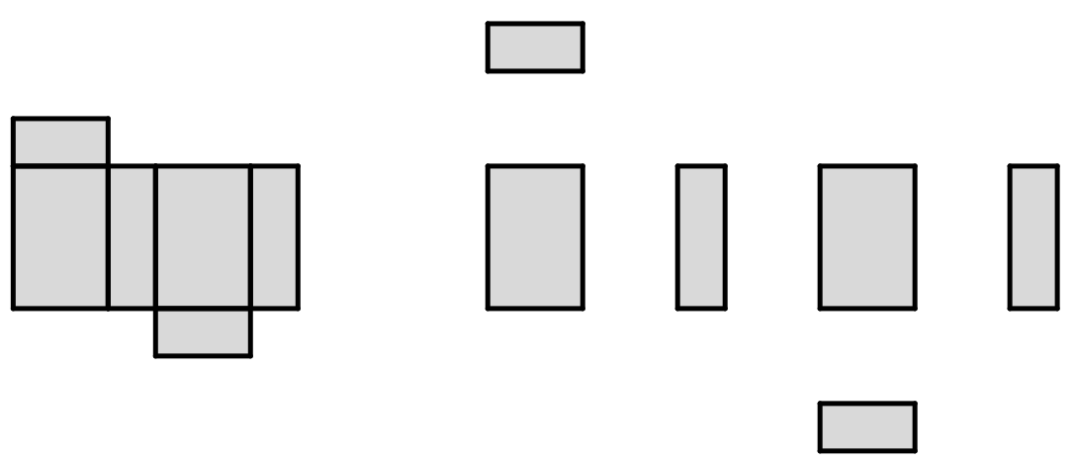
Surface area of cuboids from nets
These six rectangles can be connected to create the net of a cuboid.
What is the area of the rectangle marked a?
6 units
9 units
a
9 units
54 units²
6 units
3 units

Slide 26
Surface area of cuboids from nets
Find the area of the faces of the cuboid that are marked b and c.
6 units
3 units
c
3 units
54 units²
b =
27 units²
9 units
b
c =
18 units²
6 units
c
If a face of the net of a cuboid isn’t clearly labelled, see if you can calculate the area of the opposite face.

Slide 27
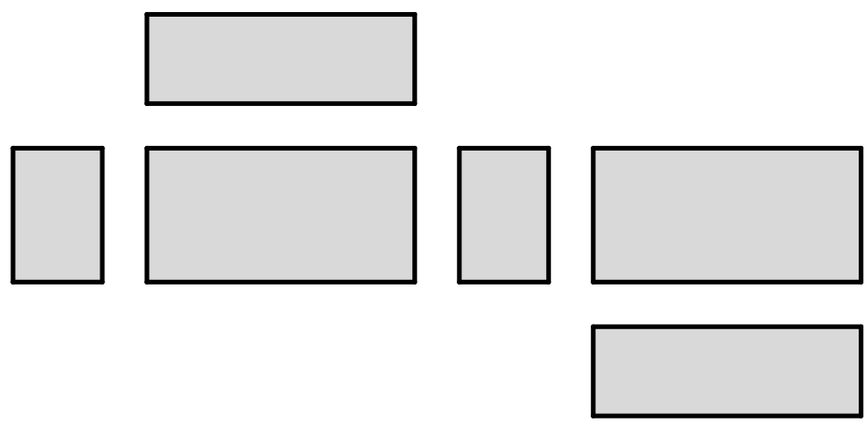
Surface area of cuboids from nets
1) These six rectangles can be connected to create the net of a cuboid.
6 units
c
a) Calculate the area of the three rectangles labelled a, b, c.
10 units
a
b
6 units
14 units
b) The three remaining rectangles have the same areas as in part a. Write the correct area on the corresponding rectangle.
c) Hence, find the surface area of the cuboid.

Slide 28
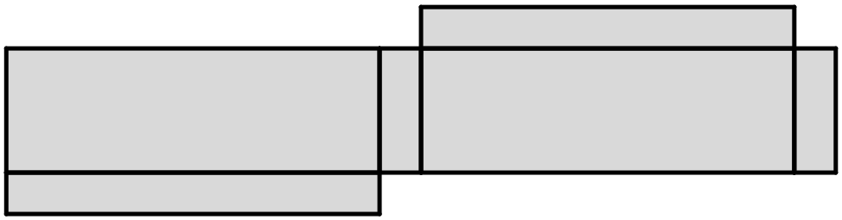
Surface area of cuboids from nets
2) By finding the area of at least three rectangles, complete the calculation to find the surface area of the cuboid which would be made from this net.
15 cm
8 cm
8 cm
25 cm
the surface area of this cuboid is:
2( + + ) = cm²

Slide 29
Surface area of cuboids from nets
1) These six rectangles can be connected to create the net of a cuboid.
6 units
c
84
a) Calculate the area of the three rectangles labelled a, b, c.
a
b
10 units
60
140
60
140
6 units
14 units
84
b) The three remaining rectangles have the same areas as in part a. Write the correct area on the corresponding rectangle.
c) Hence, find the surface area of the cuboid.
568 units²

Slide 30
Surface area of cuboids from nets
2) By finding the area of at least three rectangles, complete the calculation to find the surface area of the cuboid which would be made from this net.
15 cm
8 cm
8 cm
25 cm
the surface area of this cuboid is:
375
120
200
1390
2( + + ) = cm²

Slide 31
Surface area of cuboids
Nets of cuboids
Surface area of cuboids from nets
Surface area of cuboids from 3D representations

Slide 32
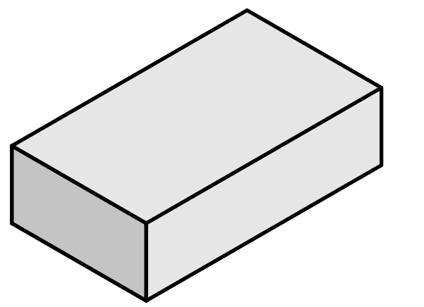
Surface area of cuboids from 3D representations
How do I calculate the area of the back face of this cuboid?
15 units
The two edge lengths at the front of the cuboid…
6 units
Will also apply to the back of the cuboid, as front and back will always have the same dimensions.
6 units
6 × 15
20 units
15 units
The area of the back face is
6 × 15 = 90 units²

Slide 33
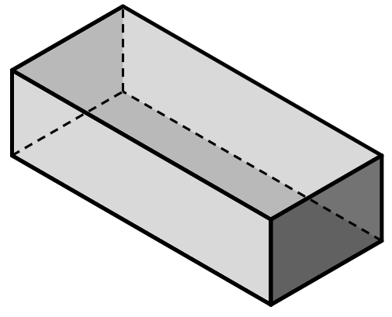
Surface area of cuboids from 3D representations
Which two edge lengths define the hidden face (marked a)?
Hence, what is the area of this face?
a
12 and 7
area = 7 × 12 = 84 units²
7 units
30 units
12 units

Slide 34
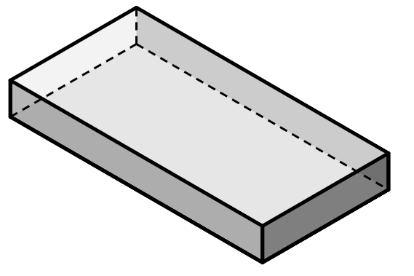
Surface area of cuboids from 3D representations
To find the surface area of this cuboid, we can add together all the faces one at a time.
front = 14 × 2 = 28
back = 14 × 2 = 28
2 cm
right = 5 × 2 = 10
14 cm
left = 5 × 2 = 10
5 cm
bottom = 14 × 5 = 70
top = 14 × 5 = 70
total surface area =
28 + 28 + 10 + 10 + 70 + 70 =
216 cm²

Slide 35
Surface area of cuboids from 3D representations
To speed up this process, you can use the fact that opposite faces have the same area.
Rather than adding the same-sized face twice…
We can double the area of one face to account for its opposite face.
front = 14 × 2 = 28
This multiply by 2 makes sure you are accounting for both the front and back!
front and back = 14 × 2 × 2 = 56
back = 14 × 2 = 28
right = 5 × 2 = 10
right and left = 5 × 2 × 2 = 20
left = 5 × 2 = 10
bottom = 14 × 5 = 70
bottom and top = 14 × 5 × 2 = 140
top = 14 × 5 = 70
total surface area =
56 + 20 + 140 =
216 cm²

Slide 36
Surface area of cuboids from 3D representations
Alternatively, we can save the doubling for the very end, after we have added the individual areas together.
front = 14 × 2 = 28
front = 14 × 2 = 28
back = 14 × 2 = 28
right = 5 × 2 = 10
right = 5 × 2 = 10
left = 5 × 2 = 10
bottom = 14 × 5 = 70
This can also be represented using brackets:
bottom = 14 × 5 = 70
top = 14 × 5 = 70
28 + 10 + 70 =
108
2(28 + 10 + 70) = 216 cm²
108 × 2 =
216 cm²

Slide 37
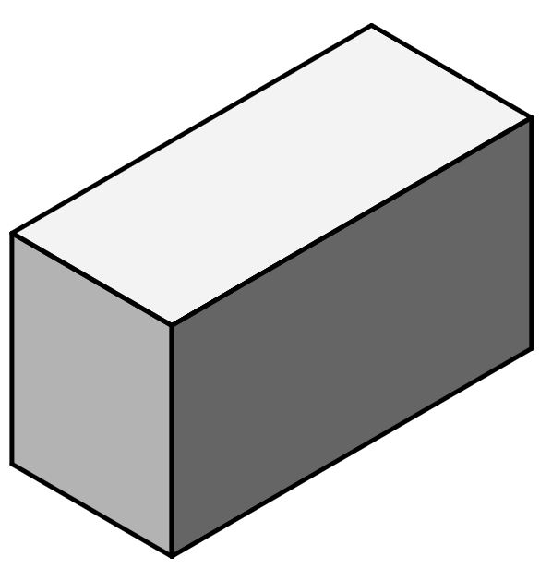
Surface area of cuboids from 3D representations
Complete the missing values in this calculation that start to find the surface area of this cuboid.
front and back = 10 × 8 × 2 = 160
10 cm
right and left = 20 × 10 × =
a
b
20 cm
8 cm
bottom and top = × × = 320
c
d
e
a
b
c
d
e
c and d can be in either order
2
400
8
20
2

Slide 38
Surface area of cuboids from 3D representations
Complete the missing values in this calculation that start to find the surface area of this cuboid.
7 cm
front =
a
right =
b
12 cm
5 cm
top = 5 × 12 = 60
2( + + 60) =
a
b
c
2( 35 + 84 + 60) = 358 cm²

Slide 39
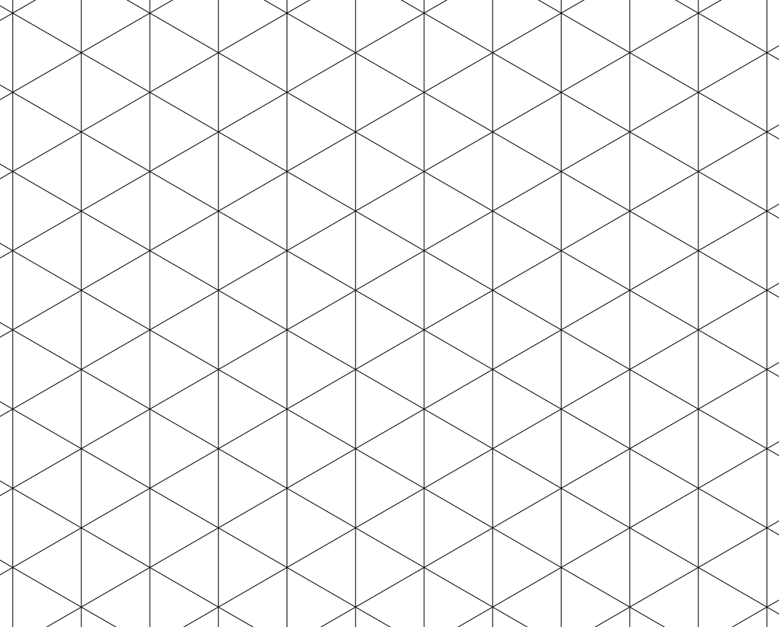
Surface area of cuboids from 3D representations
Cuboids can be drawn on an isometric grid, made of tessellating triangles, rather than grid squares.
This helps draw shapes in 3D.

Slide 40
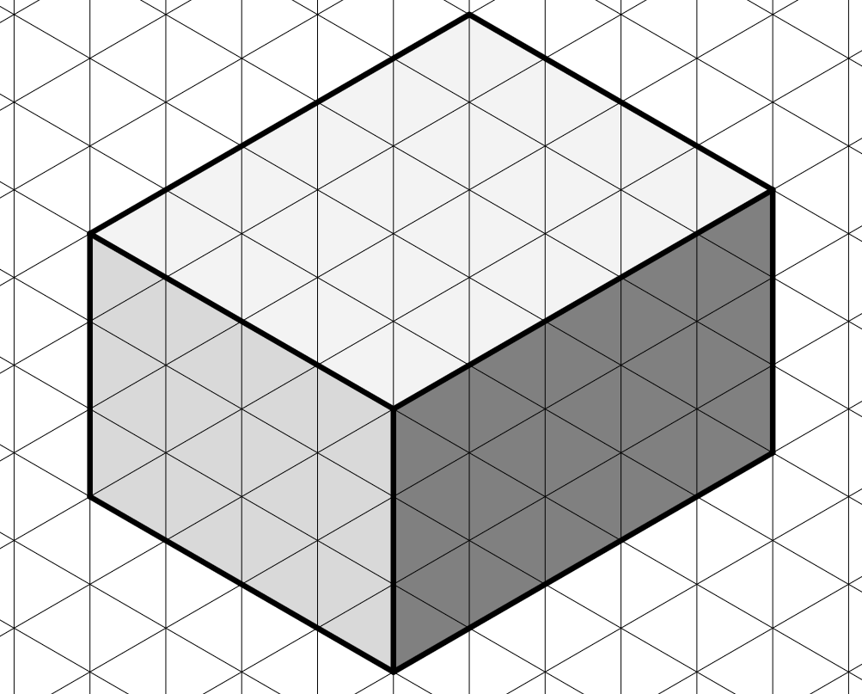
Surface area of cuboids from 3D representations
After finding the edge lengths of the cuboid, the surface area can be calculated in the same way as before.
height of 3 units
front = 3 × 4 = 12
right = 3 × 5 = 15
top = 4 × 5 = 20
width of 4 units
depth of 5 units
surface area = 2(12 + 15 + 20)
= 94 units²

Slide 41
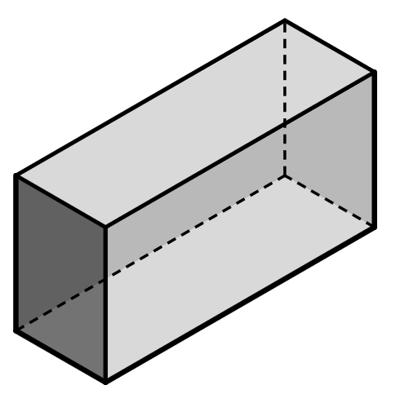
Surface area of cuboids from 3D representations
1) Complete the calculations to find the surface area of this cuboid.
front = 2 × = .
back = .
5 cm
right = × = .
left = .
bottom = 2 × 11 = .
11 cm
top = .
2 cm
surface area = .

Slide 42
Surface area of cuboids from 3D representations
2) Complete the calculations to find the surface area of this cuboid.
front and back
30 × 4 × 2 = .
4 m
left and right
× × 2 = .
30 m
12 m
top and bottom
30 × × = .
surface area = + + = .

Slide 43
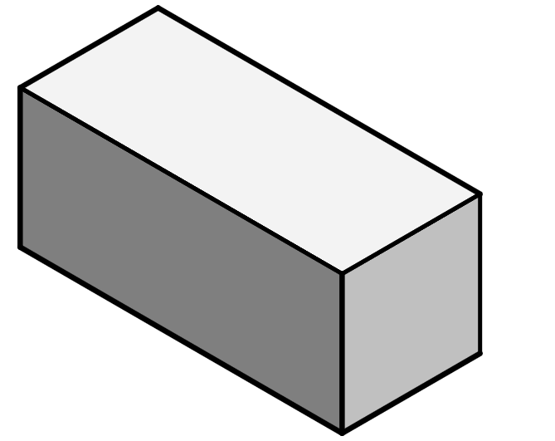
Surface area of cuboids from 3D representations
3) Complete the calculations to find the surface area of this cuboid.
front = .
right = .
top = .
7 inches
16 inches
8 inches
surface area = 2( + + ) = .

Slide 44
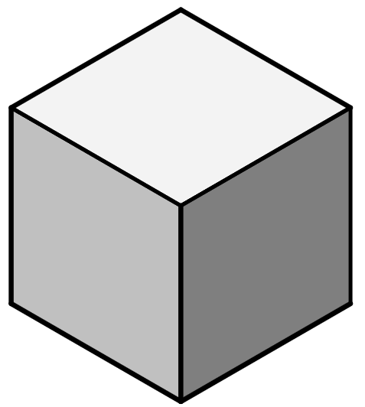
Surface area of cuboids from 3D representations
4) This is a cube.
a) Calculate the area of the front, right, and top faces of the cube, and hence calculate the surface area.
front = .
right = .
top = .
surface area = 2 ( + + ) = .
5 m
b) Jun says there is a quicker way of calculating the surface area of a cube. Is Jun correct? If so, show a more efficient calculation to find the surface area of a cube.

Slide 45
Surface area of cuboids from 3D representations
1) Complete the calculations to find the surface area of this cuboid.
5
10
front = 2 × =
10
back =
5 cm
right = × =
11
5
55
55
left =
22
11 cm
bottom = 2 × 11 =
22
2 cm
top =
174 cm²
surface area =

Slide 46
Surface area of cuboids from 3D representations
2) Complete the calculations to find the surface area of this cuboid.
front and back
30 × 4 × 2 =
240
4 m
left and right
× × 2 =
30 m
12
4
96
12 m
top and bottom
30 × × =
12
2
720
240
96
720
1056 m²
surface area = + + =

Slide 47
Surface area of cuboids from 3D representations
3) Complete the calculations to find the surface area of this cuboid.
front = .
right = .
top = .
112
7 inches
56
128
16 inches
8 inches
592 inches²
surface area = 2( + + ) = .
112
56
128

Slide 48
Surface area of cuboids from 3D representations
4) This is a cube.
a) Calculate the area of the front, right, and top faces of the cube, and hence calculate the surface area.
front =
right =
top =
surface area = 2( + + ) =
25
25
5 m
25
25
25
25
150 m²
b) Jun says there is a quicker way of calculating the surface area of a cube. Is Jun correct? If so, show a more efficient calculation to find the surface area of a cube.
6 × 5² = 150

Slide 49
Surface area of cuboids
The net of a cuboid comprises exactly six rectangles, with the edges of two adjacent rectangles having an equal side length.
The net of a cuboid can be used to calculate the surface area of the cuboid; the area of each rectangle can be calculated individually, then summed together to get the total surface area.
The surface area of a cuboid can be calculated by finding the area of each face.
An isometric grid can be used to represent a cuboid, and its surface area can be calculated from isometric grid lines.

Slide 50

© Oak National Academy 2023.
Produced in partnership with Mathematics in Education and Industry.
Licensed on the Open Government Licence v3.0, except where otherwise stated. See Oak terms and conditions.

